Slide 1
Machine Learning - Classification
Atul Kahate
https://www.linkedin.com/in/atulkahate/

Slide 2
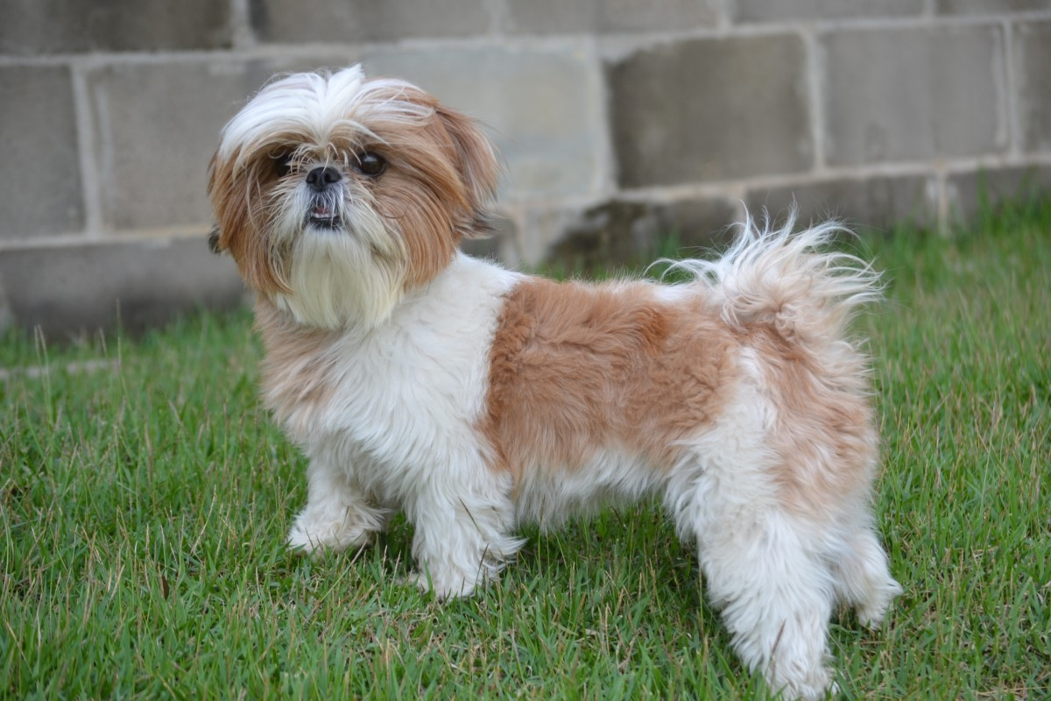
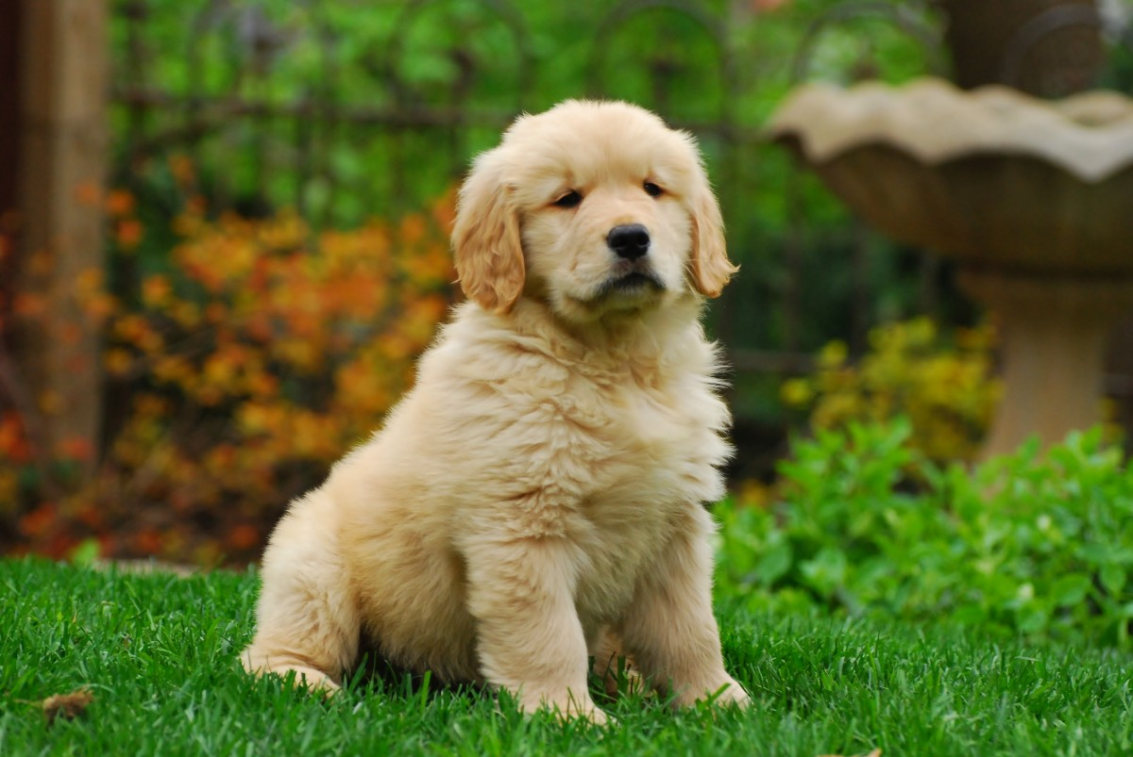
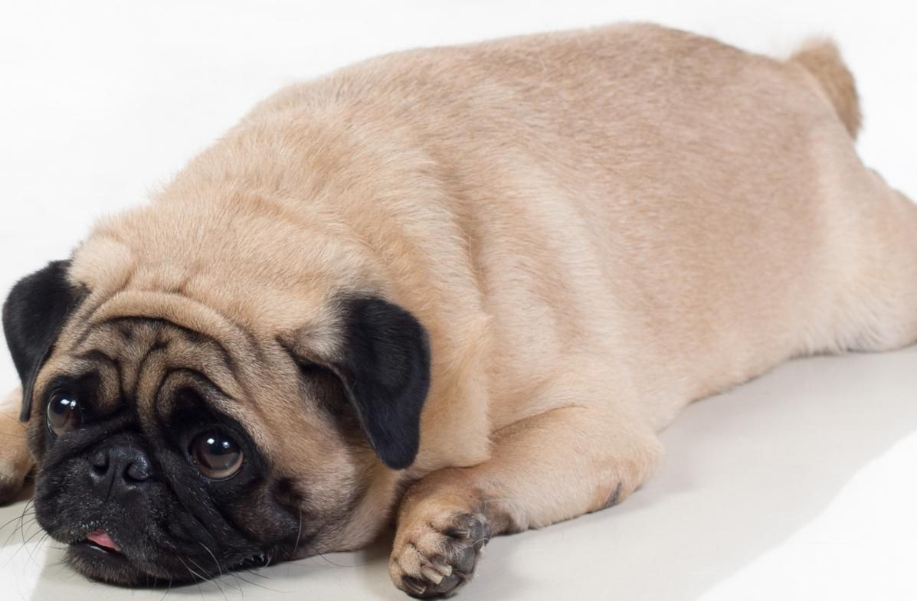
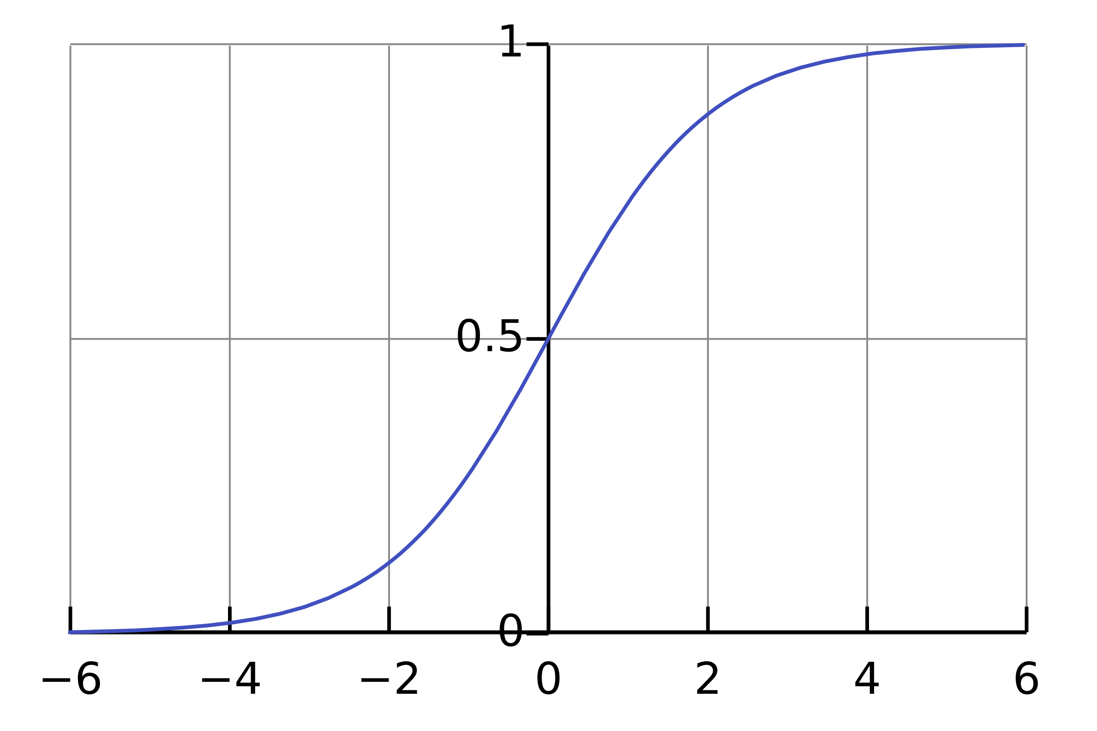
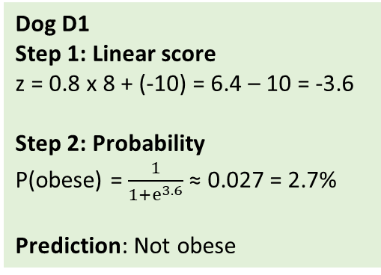
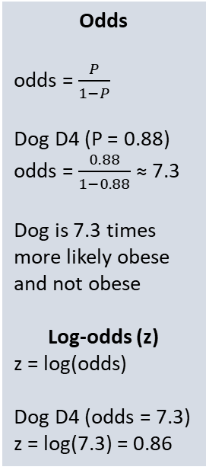
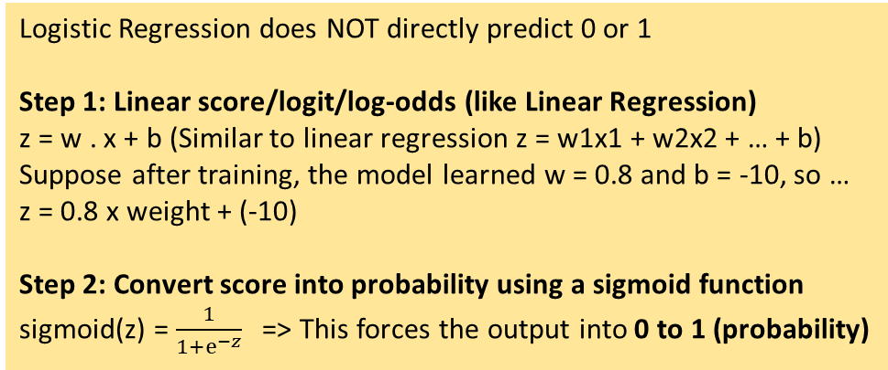
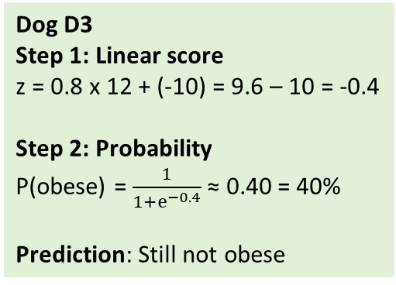
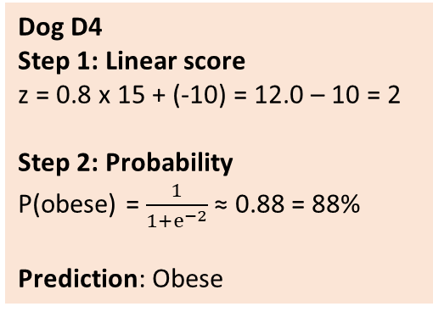
Logistic Regression: Predict Obesity for a Dog
Odds
odds = $\frac{P}{1−P}$
Dog D4 (P = 0.88)
odds = $\frac{0.88}{1−0. 88}$ ≈ 7.3
Dog is 7.3 times more likely obese and not obese
Log-odds (z)
z = log(odds)
Dog D4 (odds = 7.3)
z = log(7.3) = 0.86
Dog | Weight (kg) | Obese (y)
D1 | 8 | 0 (Not obese)
D2 | 10 | 0
D3 | 12 | 0
D4 | 15 | 1 (Obese)
D5 | 18 | 1
D6 | 22 | 1
Logistic Regression does NOT directly predict 0 or 1
Step 1: Linear score/logit/log-odds (like Linear Regression)
z = w . x + b (Similar to linear regression z = w1x1 + w2x2 + … + b)
Suppose after training, the model learned w = 0.8 and b = -10, so …
z = 0.8 x weight + (-10)
Step 2: Convert score into probability using a sigmoid function
sigmoid(z) = $\frac{1}{1+ⅇ^{−z}}$ => This forces the output into 0 to 1 (probability)
Dog D1
Step 1: Linear score
z = 0.8 x 8 + (-10) = 6.4 – 10 = -3.6
Step 2: Probability
P(obese) = $\frac{1}{1+ⅇ^{3.6}}$ ≈ 0.027 = 2.7%
Prediction: Not obese
Dog D3
Step 1: Linear score
z = 0.8 x 12 + (-10) = 9.6 – 10 = -0.4
Step 2: Probability
P(obese) = $\frac{1}{1+ⅇ^{−0.4}}$ ≈ 0.40 = 40%
Prediction: Still not obese
Dog D4
Step 1: Linear score
z = 0.8 x 15 + (-10) = 12.0 – 10 = 2
Step 2: Probability
P(obese) = $\frac{1}{1+ⅇ^{−2}}$ ≈ 0.88 = 88%
Prediction: Obese
z value | Meaning
z = 0 | Obese and not-obese equally likely (50–50)
z > 0 | More likely obese
z < 0 | More likely not obese
Large +z | Almost certainly obese
Large −z | Almost certainly not obese

Slide 3
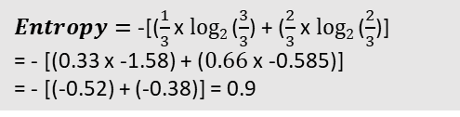
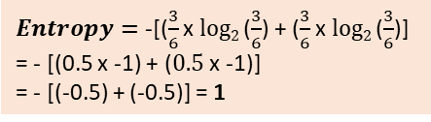
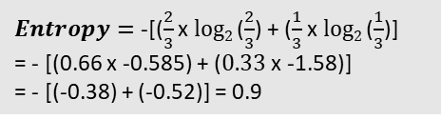
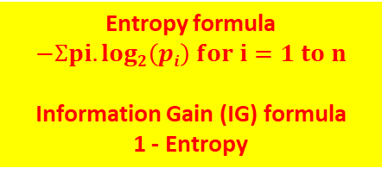
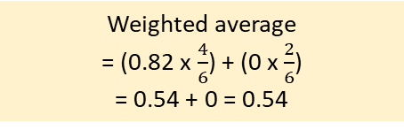
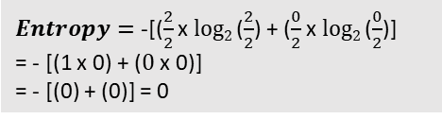
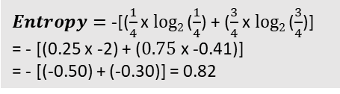
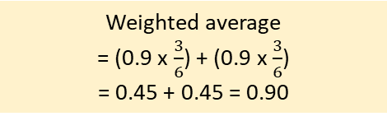
Entropy
Entropy formula
$$−Ʃpi.log2\left(pi\right) for i=1 to n$$
Information Gain (IG) formula
1 - Entropy
Split on Age
Split on Income
Income | Age | Loan Granted?
100000 | 25 | 1
50000 | 40 | 0
200000 | 30 | 1
150000 | 35 | 0
300000 | 28 | 1
110000 | 38 | 0
Criteria | Total cases | Loan Granted
Age >= 30 | 4 | Yes = 1
 | 4 | No = 3
Criteria | Total cases | Loan Granted
Income >= 1.5L | 3 | Yes = 2
 | 3 | No = 1
$Entropy=$ -[($\frac{1}{4}$ x $log2$($\frac{1}{4}$) + ($\frac{3}{4}$ x $log2$($\frac{3}{4}$)]
= - [(0.25 x -2) + ($0.75$ x -0.41)]
= - [(-0.50) + (-0.30)] = 0.82
$Entropy=$ -[($\frac{2}{3}$ x $log2$($\frac{2}{3}$) + ($\frac{1}{3}$ x $log2$($\frac{1}{3}$)]
= - [(0.66 x -0.585) + ($0.33$ x -1.58)]
= - [(-0.38) + (-0.52)] = 0.9
$Entropy=$ -[($\frac{3}{6}$ x $log2$($\frac{3}{6}$) + ($\frac{3}{6}$ x $log2$($\frac{3}{6}$)]
= - [(0.5 x -1) + ($0.5$ x -1)]
= - [(-0.5) + (-0.5)] = 1
Criteria | Total cases | Loan Granted
Age < 30 | 2 | Yes = 2
 | 2 | No = 0
Criteria | Total cases | Loan Granted
Income < 1.5L | 3 | Yes = 1
 | 3 | No = 2
Data | Entropy | Entropy Reduction (Information Gain)
Original | 1 | NA
Split on Age | 0.54 | 1 – 0.54 = 0.46
Split on Income | 0.90 | 1 – 0.90 = 0.10
$Entropy=$ -[($\frac{2}{2}$ x $log2$($\frac{2}{2}$) + ($\frac{0}{2}$ x $log2$($\frac{0}{2}$)]
= - [(1 x 0) + ($0$ x 0)]
= - [(0) + (0)] = 0
$Entropy=$ -[($\frac{1}{3}$ x $log2$($\frac{3}{3}$) + ($\frac{2}{3}$ x $log2$($\frac{2}{3}$)]
= - [(0.33 x -1.58) + ($0.66$ x -0.585)]
= - [(-0.52) + (-0.38)] = 0.9
Weighted average
= (0.82 x $\frac{4}{6}$) + (0 x $\frac{2}{6}$)
= 0.54 + 0 = 0.54
Weighted average
= (0.9 x $\frac{3}{6}$) + (0.9 x $\frac{3}{6}$)
= 0.45 + 0.45 = 0.90
Split on Age is better

Slide 4
Decision Tree
Label: Loan Granted?
Original dataset
Features
Age
Income
No: 3
Yes: 3
Age
Splitting on Age
>=30
<30
No: 3
Yes: 1
No: 0
Yes: 2

Slide 5
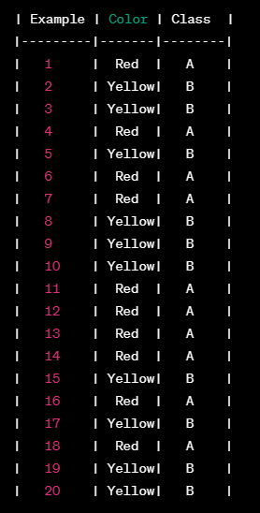
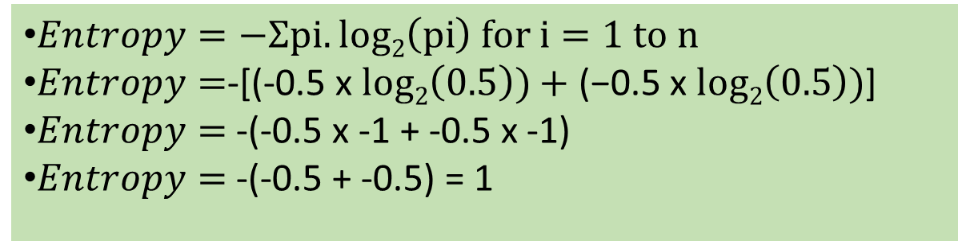
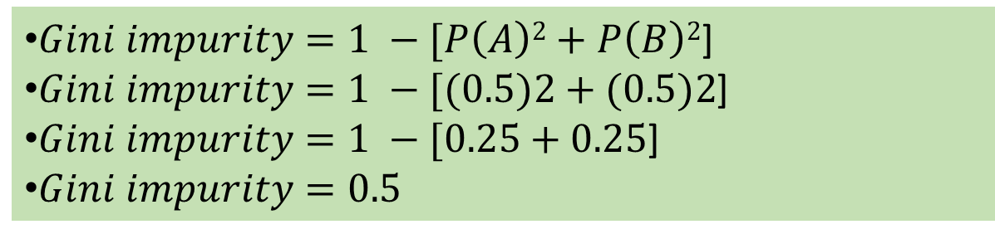
Gini Index/Coefficient/Impurity
P(A) = 10/20 = 0.5
P(B) = 10/20 = 0.5
Gini impurity Alternative to entropy (Lower the better, 0 is the best)
Example: Predict fruit: A or B
$Entropy=−Ʃpi.log2\left(pi\right) for i=1 to n$
$Entropy=$-[(-0.5 x $log2\left(0.5\right))+\text{(−0.5 }\text{x} log2\left(0.5\right))$]
$Entropy=$ -(-0.5 x -1 + -0.5 x -1)
$Entropy=$ -(-0.5 + -0.5) = 1
$Gini impurity=1 −[P\left(A\right)2+P\left(B\right)2$]
$Gini impurity=1 −[(0.5)2+(0.5)2$]
$Gini impurity=1 −[0.25+0.25$]
$Gini impurity=0.5$

Slide 6
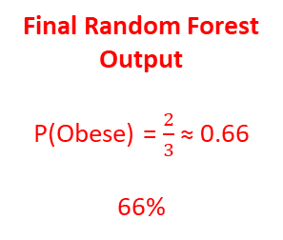
Random Forest
Split 1: Is weight ≤ 13 kg?
Split 2: Is weight ≤ 14 kg?
Split 3: Is weight ≤ 12 kg?
Dog | Weight | Obese | Left (≤13) | Right (>13)
D1 | 8 | 0 | Yes | -
D2 | 10 | 0 | Yes | -
D3 | 12 | 0 | Yes | -
D4 | 15 | 1 | - | Yes
D5 | 18 | 1 | - | Yes
D6 | 22 | 1 | - | Yes
Dog | Weight | Obese | Left (≤14) | Right (>14)
D1 | 8 | 0 | Yes | -
D2 | 10 | 0 | Yes | -
D3 | 12 | 0 | Yes | -
D4 | 15 | 1 | - | Yes
D5 | 18 | 1 | - | Yes
D6 | 22 | 1 | - | Yes
Dog | Weight | Obese | Left (≤13) | Right (>13)
D1 | 8 | 0 | Yes | -
D2 | 10 | 0 | Yes | -
D3 | 12 | 0 | Yes | -
D4 | 15 | 1 | - | Yes
D5 | 18 | 1 | - | Yes
D6 | 22 | 1 | - | Yes
Tree says:
When weight <= 13, P(Obese) = 0/3 = 0
When weight > 13, P(Obese) = 3/3 = 1
Tree says :
When weight <= 14, P(Obese) = 0/3 = 0
When weight > 14, P(Obese) = 3/3 = 1
Tree says :
When weight <= 12, P(Obese) = 0/3 = 0
When weight > 12, P(Obese) = 3/3 = 1
Dog | Weight (kg) | Obese (y)
D1 | 8 | 0 (Not obese)
D2 | 10 | 0
D3 | 12 | 0
D4 | 15 | 1 (Obese)
D5 | 18 | 1
D6 | 22 | 1
Tree | Prediction
Tree 1 | weight <= 13 -> 0, else 1
Tree 2 | weight <= 14 -> 0, else 1
Tree 3 | weight <= 12 -> 0, else 1
Tree | Prediction
Tree 1 | Obese
Tree 2 | Not obese
Tree 3 | Obese
Final Random Forest Output
P(Obese) = $\frac{2}{3}$ ≈ 0.66
66%
Original data
Random Forest
Prediction for a new dog (weight = 14)

Slide 7
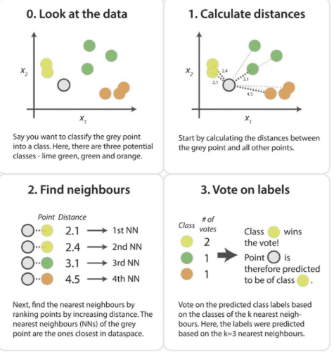
K-Nearest Neighbours (KNN)
A supervised machine learning algorithm used for classification and regression based on similarity
Goal
  Predict the label of a new data point
  Look at the K closest data points
  Decide based on majority vote (classification)
Working
  Choose K (number of neighbours)
  Measure distance from the new point to all training points
  Select the K nearest neighbours
  Assign the most common class among them

Slide 8
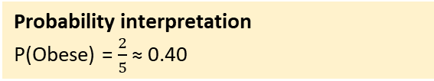
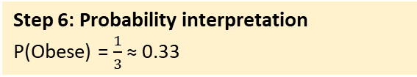
K-Nearest Neighbours (KNN)
“You are the average of your neighbours”
Dog | Weight (kg) | Obese (y)
D1 | 8 | 0 (Not obese)
D2 | 10 | 0
D3 | 12 | 0
D4 | 15 | 1 (Obese)
D5 | 18 | 1
D6 | 22 | 1
Step 4: Pick 3 nearest neighbours
Sort by distance
What if K = 5?
Meaning: Look at 5 nearest dogs
Dog | Obese
D4 (15) | 1
D3 (12) | 0
D2 (10) | 0
Dog | Obese
D4 | 1
D3 | 0
D2 | 0
D5 | 1
D1 | 0
Step 5: Voting
Obese = 1 vote, Not obese = 2 votes
Final prediction: Not obese
Step 1: Choose K (e.g. 3)
Meaning: Look at the 3 closest dogs
Voting
Obese = 2 vote, Not obese = 3 votes
Final prediction: Not obese
Step 6: Probability interpretation
P(Obese) = $\frac{1}{3}$ ≈ 0.33
Step 2: A new dog arrives (weight = 14 kg)
Step 3: Compute distances to all dogs
Probability interpretation
P(Obese) = $\frac{2}{5}$ ≈ 0.40
Dog | Weight | Obese | Distance
D1 | 8 | 0 | 6
D2 | 10 | 0 | 4
D3 | 12 | 0 | 2
D4 | 15 | 1 | 1
D5 | 18 | 1 | 4
D6 | 22 | 1 | 8
K | Behavior
Small K (e.g. 1) | Very noisy, overfits
Large K | Smooth, may underfit
How KNN learns? It does not!
Training = Storing the data
Prediction = Computing the distances
Called a “lazy learner”

Slide 9
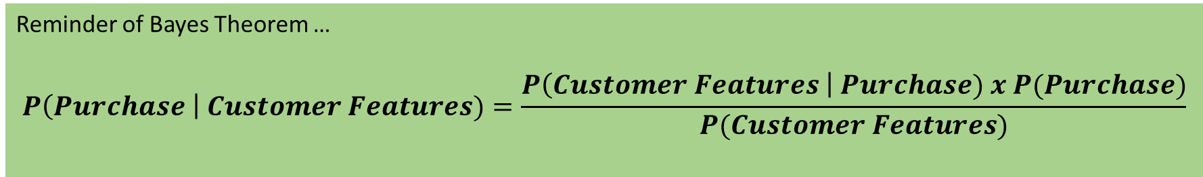

Naïve Bayes: Recap
Customer Id | Newsletter? | Social Media? | Website? | Purchase?
1 | 0 | 1 | 0 | 1
2 | 1 | 0 | 1 | 0
3 | 1 | 1 | 0 | 1
4 | 0 | 0 | 0 | 0
5 | 1 | 0 | 0 | 0
6 | 1 | 1 | 1 | 1
7 | 0 | 1 | 1 | 1
8 | 1 | 0 | 1 | 0
9 | 0 | 0 | 1 | 0
10 | 1 | 1 | 0 | 1
11 | 1 | 0 | 1 | ?
12 | 0 | 1 | 1 | ?
Reminder of Bayes Theorem …
$$P\left(A \right| B)=\frac{P\left(B\right|A) x P(A)}{P(B)}$$
Reminder of Bayes Theorem …
$$P\left(Purchase \right| Customer Features)=\frac{P\left(Customer Features \right| Purchase) x P(Purchase)}{P(Customer Features)}$$

Slide 10
Naïve Bayes
Step 1: Calculate base/unconditional probabilities
Total customers = 10
Count (Purchased = 1) = 5
Count (Purchased = 0) = 5
P(Purchased = 1) = 5/10 = 0.5
P(Purchased = 0) = 5/10 = 0.5
Step 2: Calculate conditional probabilities for each class
Feature | Count for Purchase = 1 | Purchase = 1 | Probability
Subscribed = 1 | 3 (customers 3, 6, 10) | 5 | 3/5 = 0.6
Follows = 0 | 1 (No customer, so considering as 1) | 5 | 1/5 = 0.2
Visited = 1 | 2 (customers 6, 7) | 5 | 2/5 = 0.4
Customer 11: (1, 0, 1)
P(Purchase = 1 | (1, 0, 1))
= P(1) × P(Sub = 1 ∣ 1) × P(Follows = 0 ∣ 1) × P(Visit = 1 ∣ 1)
= 0.5 × 0.6 × 0.2 × 0.4 = 0.024
Customer Id | Newsletter? | Social Media? | Website? | Purchase?
1 | 0 | 1 | 0 | 1
2 | 1 | 0 | 1 | 0
3 | 1 | 1 | 0 | 1
4 | 0 | 0 | 0 | 0
5 | 1 | 0 | 0 | 0
6 | 1 | 1 | 1 | 1
7 | 0 | 1 | 1 | 1
8 | 1 | 0 | 1 | 0
9 | 0 | 0 | 1 | 0
10 | 1 | 1 | 0 | 1
11 | 1 | 0 | 1 | ?
12 | 0 | 1 | 1 | ?
Feature | Count for Purchase = 0 | Purchase = 1 | Probability
Subscribed = 1 | 3 (customers 2, 5, 8) | 5 | 3/5 = 0.6
Follows = 0 | 3 (customers 2, 5, 8) | 5 | 3/5 = 0.6
Visited = 1 | 3 (customers 2, 8, 9) | 5 | 3/5 = 0.6
Customer 11: (1, 0, 1)
P(Purchase = 0 | (1, 0, 1))
= P(1) × P(Sub = 1 ∣ 0) × P(Follows = 0 ∣ 0) × P(Visit = 1 ∣ 0)
= 0.5 × 0.6 × 0.6 × 0.6 = 0.108
Conclusion:
Since 0.108 > 0.024,
Prediction: Customer 11 will NOT purchase

Slide 11
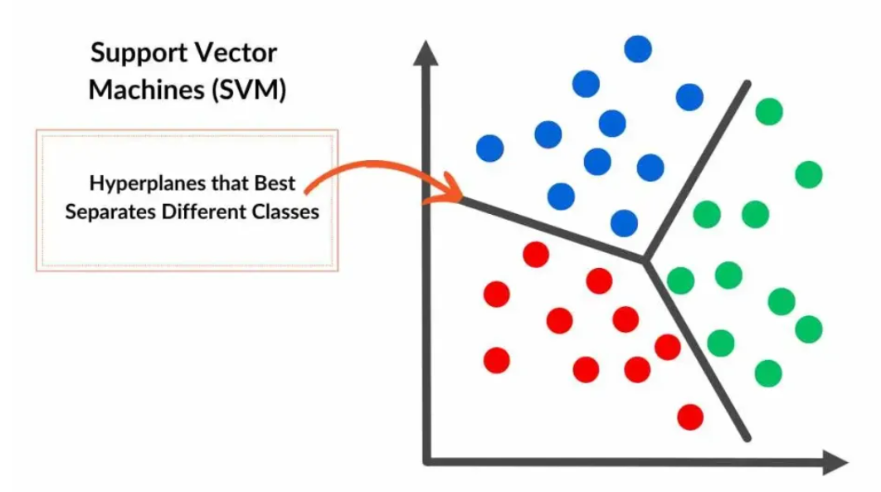
Support Vector Machines (SVM)
A supervised machine learning algorithm used for classification and regression, especially effective in high-dimensional data
Goal
  Find a decision boundary (hyperplane) that best separates classes
  Maximize the margin between classes
Working
  Identify the closest points from each class (support vectors)
  Find the hyperplane that maximizes the margin
  Use kernels to handle non-linear separation

Slide 12
Support Vector Machines (SVM)
“Find a boundary that separates obese and not-obese dogs with the maximum margin”
Step 2: Margin Intuition
SVM looks at the closest dogs from each class
Closest dogs to the boundary
Not obese -> D3 (12 kg)
Obese -> D4 (15 kg)
Step 5: Final SVM rule
IF weight < 13.5 → Not Obese
ELSE → Obese
Dog | Weight (kg) | Obese (y)
D1 | 8 | 0 (Not obese)
D2 | 10 | 0
D3 | 12 | 0
D4 | 15 | 1 (Obese)
D5 | 18 | 1
D6 | 22 | 1
Step 6: Why “Support Vectors”?
Because
Only D3 and D4 determine the boundary
Other points do not matter
If we remove D1 or D6, the boundary remains the same
If we move D3 or D4, boundary moves
Step 4: Maximum Margin Decision
Distance between closest opposite-class points: Margin = 15 – 12 = 3
SVM places the boundary exactly at the middle: Boundary = 13.5
This
Maximizes separation
Minimizes sensitivity to noise
Step 1: Define a boundary
Example: Weight = 13.5 kg
Left -> Not obese
Right -> Obese
But why not 12.5, 13, 14, …?
Step 8: What if data is not perfectly separable?
Consider dog with Weight = 13 but Obese
Messy data -> Perfect separation is not possible

Slide 13

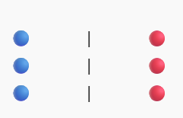
SVM – Diabetes
Consider
Each patient = One dot
Two colors: 🔵 No diabetes (0), 🔴 Diabetes (1)
Our job: Draw one line that separates blue from the red
Our SVM code
model = SVC(
kernel="rbf",
C=1.0,
gamma="scale",
probability=True
)
kernel = rbf => Radial Basis Function (SVM boundary can be curved, not linear)
C = 1.0 => Real data may not separate points in a straight line due to outliers
Small C: Ignore outliers, keep the margin large
Large C: Do not misclassify anyone, let the margin be small
Scale: C = 0.001 0.01 0.1 1 10 100 1000
↑
balanced
gamma: SVM works by looking at a patient and asking, "Which other patients in my database are similar to this one?"
Gamma defines how far that "similarity bubble" reaches
Example: If a patient has a Glucose of 150 and a BMI of 30, Gamma decides if the model should only compare them to people with exactly 150 Glucose, or everyone between 120 and 180
gamma = scale -> Do it automatically
SVM predicts 0/1, but probability = true will ask it to predict probability
Many lines can separate data
Suppose our data is like this
We can draw
A line close to blue
A line close to red
A line in the middle
All are valid separators
SVM asks: Which is the BEST line?
1. Tries MANY possible separating lines
2. For each line:
Measures distance to nearest blue point
Measures distance to nearest red point
3. Keeps the line where:
the minimum distance is maximum
SVM chooses the line that is farthest away from the closest points on both sides
The distance is called margin
Closest points are called support vectors

Slide 14
Confusion Matrix
Confusion matrix: A table that summarizes how well a classification model performs — by comparing actual labels with predicted labels
Tells us where our model is getting confused — i.e. which classes it is mixing up
Symbol | Meaning
H₀ | Null hypothesis — the “default” or “no effect” assumption
H₁ | Alternative hypothesis — the competing claim, suggesting a difference or effect
Hypothesis | Statement
H₀: Email is NOT spam | Default assumption: the email is legitimate (ham)
H₁: Email IS spam | Alternative assumption: the email is spam

Slide 15

Confusion Matrix
Model decision = Hypothesis Test
  When the model predicts a probability (say $P\left(\text{Spam}\right)=0.8)$
    If $P\left(\text{Spam}\right)≥0.5$→ we reject $H_{0}$(decide email is spam)
    If $P\left(\text{Spam}\right)<0.5$→ we fail to reject $H_{0}($decide email is not spam)
Connecting to Confusion Matrix
Actual | Model Decision | What happened (statistically) | Type of Error / Correctness
Not spam (H₀ true) | Predicted not spam | Correctly accepted H₀ | True Negative
Not spam (H₀ true) | Predicted spam | Wrongly rejected H₀ | False Positive (Type I error)
Spam (H₁ true) | Predicted spam | Correctly rejected H₀ | True Positive
Spam (H₁ true) | Predicted not spam | Failed to reject H₀ | False Negative (Type II error)

Slide 16
Confusion Matrix
Structure
Example
 | Predicted: 0 (Ham / Not Spam) | Predicted: 1 (Spam)
Actual: 0 (Ham) | TN – True Negative (Correctly predicted Not Spam) | FP – False Positive (Predicted Spam but actually Not Spam)
Actual: 1 (Spam) | FN – False Negative (Predicted Not Spam but actually Spam) | TP – True Positive (Correctly predicted Spam)
 | Predicted: 0 (Ham) | Predicted: 1 (Spam)
Actual: 0 (Ham) | 90 (TN) | 10 (FP)
Actual: 1 (Spam) | 20 (FN) | 80 (TP)

Slide 17
Confusion Matrix: Another Example
H₀ (Negative): Defendant is NOT guilty
H₁ (Positive): Defendant IS guilty
Reality: Defendant is NOT guilty
Total juries: 20
17 juries think “not guilty” and 3 juries think “guilty”
True Negative (CORRECT)
  Reality: Not guilty
  Jurie decision: Not guilty
  Count = 17
True Positive (CORRECT)
  Reality: Guilty
  Jurie decision: Guilty
  Count = 0
False Positive (WRONG)
  Reality: Not guilty
  Jurie decision: Guilty
  Count = 3
  Type I Error
False Negative (WRONG)
  Reality: Guilty
  Jurie decision: Not guilty
  Count = 0
  Type II Error
Actual ↓ / Predicted → | Not Guilty (0) | Guilty (1)
Not Guilty (0) | TN = 17 | FP = 3
Guilty (1) | FN = 0 | TP = 0

Slide 18
Confusion Matrix: Another Example
H₀ (Negative): Patient does NOT have a disease
H₁ (Positive): Patient HAS a disease
Total patients: 20
Reality:
  10 patients have the disease
  10 patients do NOT have the disease
Test results:
  Among 10 sick patients:
    7 tested positive
    3 tested negative
  Among 10 healthy patients:
    6 tested negative
    4 tested positive

Slide 19
Confusion Matrix: Another Example
H₀ (Negative): Patient does NOT have a disease
H₁ (Positive): Patient HAS a disease
Total patients: 20
Reality:
  10 patients have the disease
  10 patients do NOT have the disease
Test results:
  Among 10 sick patients:
    7 tested positive
    3 tested negative
  Among 10 healthy patients:
    6 tested negative
    4 tested positive
True Negative (CORRECT)
  Reality: No disease
  Test: No disease
  Count = 6
True Positive (CORRECT)
  Reality: Disease
  Test: Disease
  Count = 7
False Positive (WRONG)
  Reality: No disease
  Test: Disease
  Count = 4
  Type I Error
False Negative (WRONG)
  Reality: Disease
  Jurie decision: No disease
  Count = 3
  Type II Error

Slide 20
Confusion Matrix: Another Example
H₀ (Negative): Patient does NOT have a disease
H₁ (Positive): Patient HAS a disease
Total patients: 20
Reality:
  10 patients have the disease
  10 patients do NOT have the disease
Test results:
  Among 10 sick patients:
    7 tested positive
    3 tested negative
  Among 10 healthy patients:
    6 tested negative
    4 tested positive
True Negative (CORRECT)
  Reality: No disease
  Test: No disease
  Count = 6
True Positive (CORRECT)
  Reality: Disease
  Test: Disease
  Count = 7
False Positive (WRONG)
  Reality: No disease
  Test: Disease
  Count = 4
  Type I Error
False Negative (WRONG)
  Reality: Disease
  Jurie decision: No disease
  Count = 3
  Type II Error
Actual ↓ / Predicted → | No disease (0) | Disease (1)
No disease (0) | TN = 6 | FP = 4
Disease (1) | FN = 3 | TP = 7

Slide 21
Metrics Derived From Confusion Matrix
Metric | Formula | Meaning | Example (TN=90, FP=10, FN=20, TP=80) | Value
Accuracy | (TP + TN) / (TP + TN + FP + FN) | Overall correctness | (80+90)/ (80+90+10+20) | 0.85
Precision | TP / (TP + FP) | Of predicted positives, how many were correct | 80/ (80+10) | 0.89
Recall (Sensitivity) | TP / (TP + FN) | Of actual positives, how many were caught | 80/ (80+20) | 0.80
Specificity | TN / (TN + FP) | Of actual negatives, how many were correct | 90/ (90+10) | 0.90
F1 Score | 2 × (Precision × Recall) / (Precision + Recall) | Balance between precision and recall | 2×(0.89×0.80)/ (0.89+0.80) | 0.84

Slide 22
Interpretation of Python Classification Report
Metric | Definition | Class 0 Value | Class 1 Value | Interpretation
Support | The actual number of occurrences of each class in the test set. | 150 | 81 | There are 150 instances of Class 0 and 81 instances of Class 1. The dataset is imbalanced, with Class 0 having almost twice as many samples as Class 1.
Precision | The proportion of positive identifications that were actually correct. | 0.80 | 0.73 | When the model predicts Class 0, it is correct 80% of the time. When it predicts Class 1, it is correct 73% of the time. The model is better at precisely predicting Class 0.
Recall | The proportion of actual positives that were correctly identified. | 0.88 | 0.60 | The model correctly identifies 88% of all actual Class 0 instances. It only correctly identifies 60% of all actual Class 1 instances. This is a significant weakness for Class 1.
F1-Score | The harmonic mean of Precision and Recall. A balanced measure, especially useful for imbalanced datasets. | 0.84 | 0.66 | The model's performance on Class 0 (0.84) is notably better than its performance on Class 1 (0.66), reflecting the higher recall for Class 0 and lower recall for Class 1.

Slide 23
Hyperparameter Tuning
Hyperparameter: Settings we choose, not values learnt from data
They control how a model learns
  K in KNN, C in SVM, Depth in Decision Trees
Hyperparameter Optimization Methods
Method | What it means (simple) | When to use
Manual Search | You change values yourself based on experience | Small models, learning stage
Grid Search | Try all possible combinations of parameters | When parameters are few
Random Search | Try random combinations within a range | When parameters are many

Slide 24
Techniques Compared
Algorithm | Core idea (intuition) | Data size it likes | Interpretability | Handles non-linearity | Sensitive to scaling? | When to use (simple rule)
Logistic Regression | Probability-based linear classifier | Small → Large | ✅ High | ❌ No | ⚠️ Yes | Need probabilities + explanation
Naive Bayes | Independent features + probability | Medium → Very large | ⚠️ Medium | ❌ No | ❌ No | Text data, fast baseline
Decision Tree | Human-like if–else rules | Small → Medium | ✅ Very high | ✅ Yes | ❌ No | Need clear decision logic
Random Forest | Many trees → stable decisions | Medium → Large | ⚠️ Medium | ✅ Yes | ❌ No | Need accuracy + robustness
k-NN | Tell me your neighbors | Small → Medium | ❌ Low | ✅ Yes | ⚠️ Yes | Similarity-based problems
SVM | Maximum-margin boundary | Small → Medium | ❌ Low | ✅ Yes (kernel) | ⚠️ Yes | High-dimensional, complex data

Slide 25
When to Use What
# | Use case | Model | Reason (simple)
1 | Email spam detection (text) | Naive Bayes | Probabilistic, works great on word counts
2 | Medical diagnosis (binary outcome) | Logistic Regression | Interpretable probabilities
3 | Credit approval system | Decision Tree | Explainable rules
4 | Fraud detection | Random Forest | Handles complexity + nonlinearity
5 | Image classification (small dataset) | k-NN | Similar images → similar class
6 | Face recognition embeddings | SVM | Strong margin-based classifier
7 | Customer churn prediction | Logistic Regression | Stable, interpretable
8 | Loan default prediction | Random Forest | Captures feature interactions
9 | Medical rule-based diagnosis | Decision Tree | If–else logic
10 | Document classification | Naive Bayes | Fast + scalable
11 | Handwritten digit recognition | SVM | Non-linear boundaries
12 | Recommendation systems (similar users) | k-NN | Similarity-based reasoning
13 | Risk scoring systems | Logistic Regression | Probability output
14 | Sensor-based fault detection | Random Forest | Robust to noise
15 | Small dataset, high dimension | SVM | Works well in high-D spaces

